Slide 1
Jerome Lefebvre
Manager @ Aurecon within Asset Management Performance
This talk is inspired by work at Aurecon but not done as part of Aurecon
Last 10 years
Helping companies gain operational efficiencies using real-time data
GIS credentials:
Building them right now
https://github.com/JeromeLefebvre/DuckDB-Era5-Transmission
Today:
Measuring the impact of weather on the electricity grid (using DuckDB and Python)

Slide 2
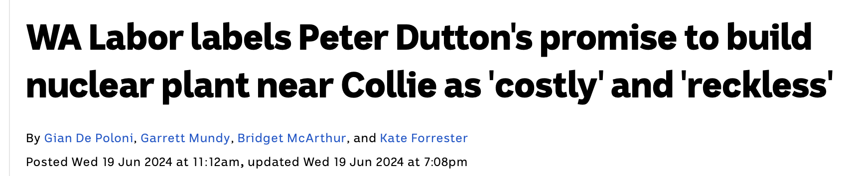
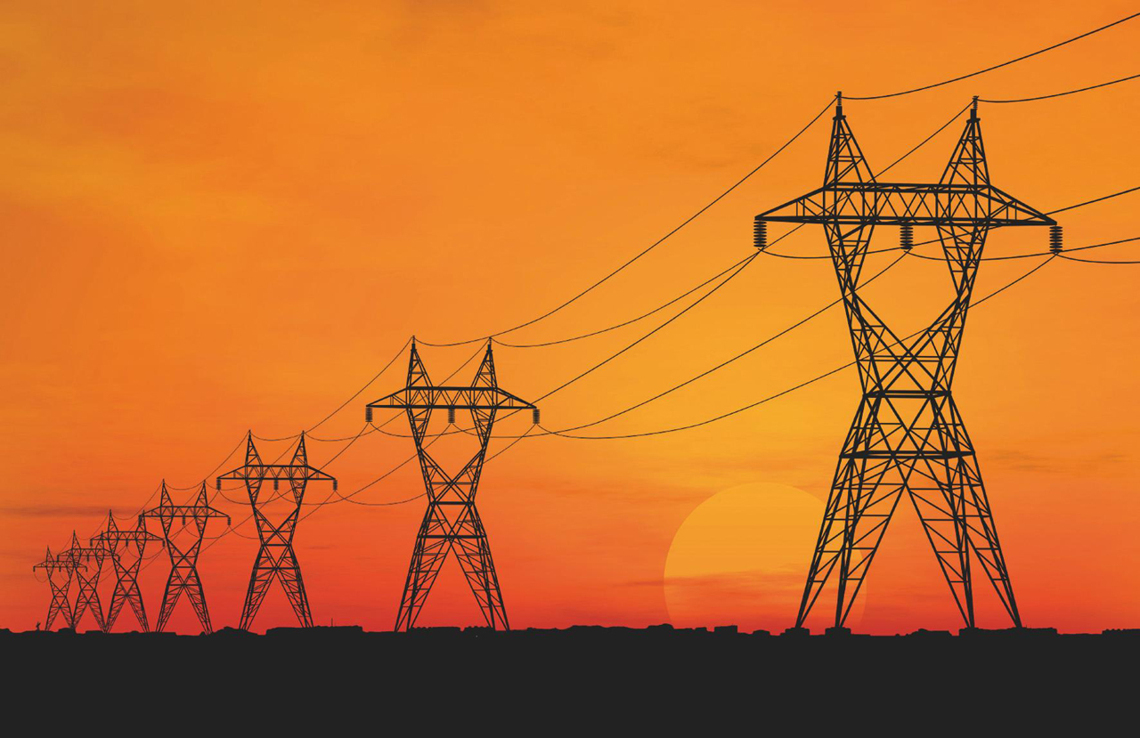
The WA energy future and the grid
WA Energy transmission:
Solar
Wind
Batteries
Lots of hope
Transmission lines are hard:
There is a backlog
Costly
Our favourite pastime is NIMBYsm

Slide 3
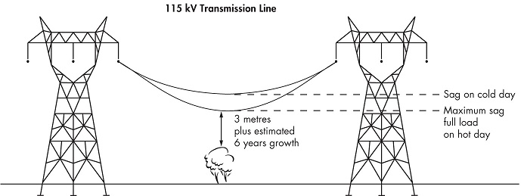
Weather's impact on transmission lines: SAG
Risk:
Fires
Trips
Safety
There is also a loss of operational efficiency as sag leads to less capacity of the grid

Slide 4
Thermal Capacity
Maximal Thermal Capacity
Net Current Carrying Capacity

Slide 5
Thermal Capacity
Heat Gain:
High ambient temp
Solar irradiance
Maximal Thermal Capacity
Net Current Carrying Capacity

Slide 6
Thermal Capacity
Heat Gain:
High ambient temp
Solar irradiance
Maximal Thermal Capacity
Net Current Carrying Capacity
Heat Loss:
Low ambient temp
Wind

Slide 7
Thermal Capacity
Heat Gain:
High ambient temp
Solar irradiance
Maximal Thermal Capacity
Net Current Carrying Capacity
Heat Loss:
Low ambient temp
Wind
Static Rating
Potential Capacity

Slide 8
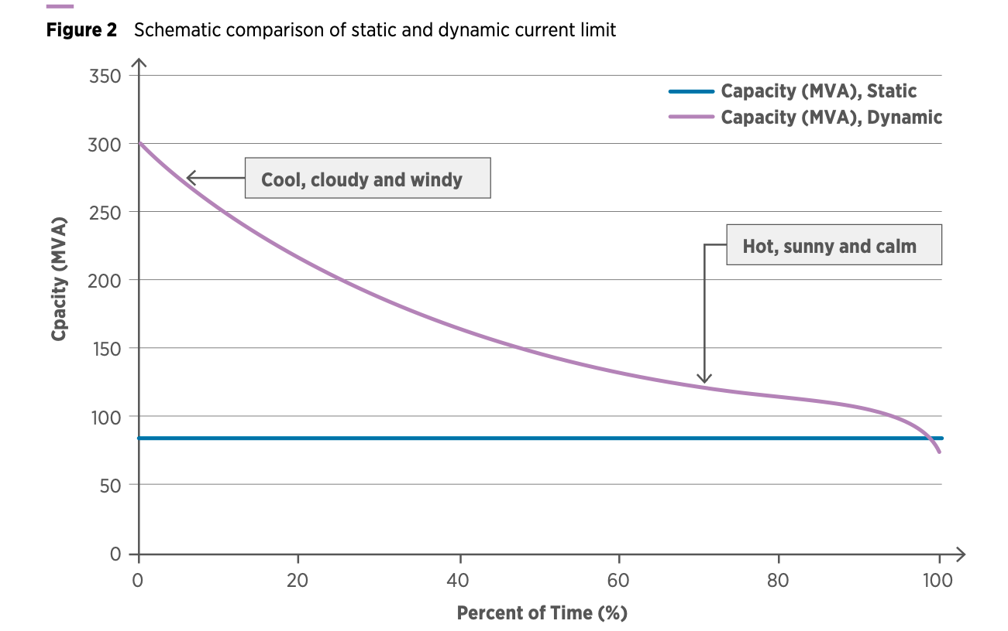
Loss opportunity!
Static Capacity

Slide 9
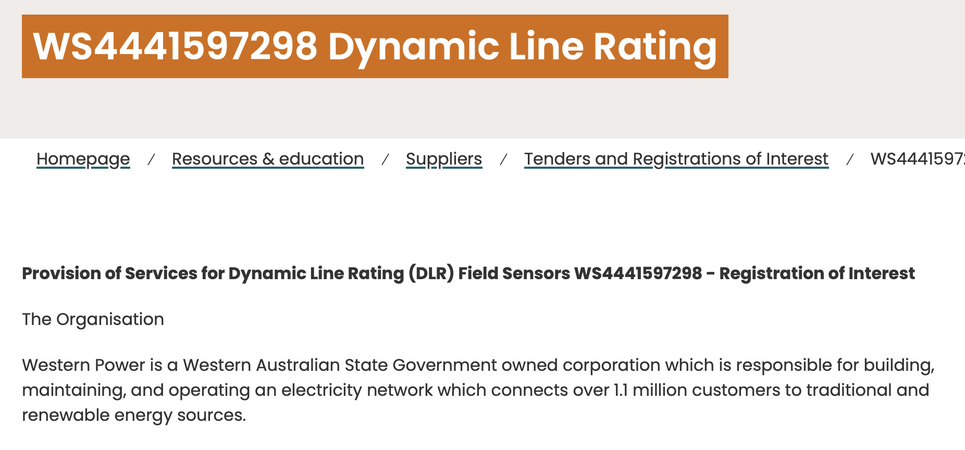
Approach: Attach sensors all over the place

Slide 10

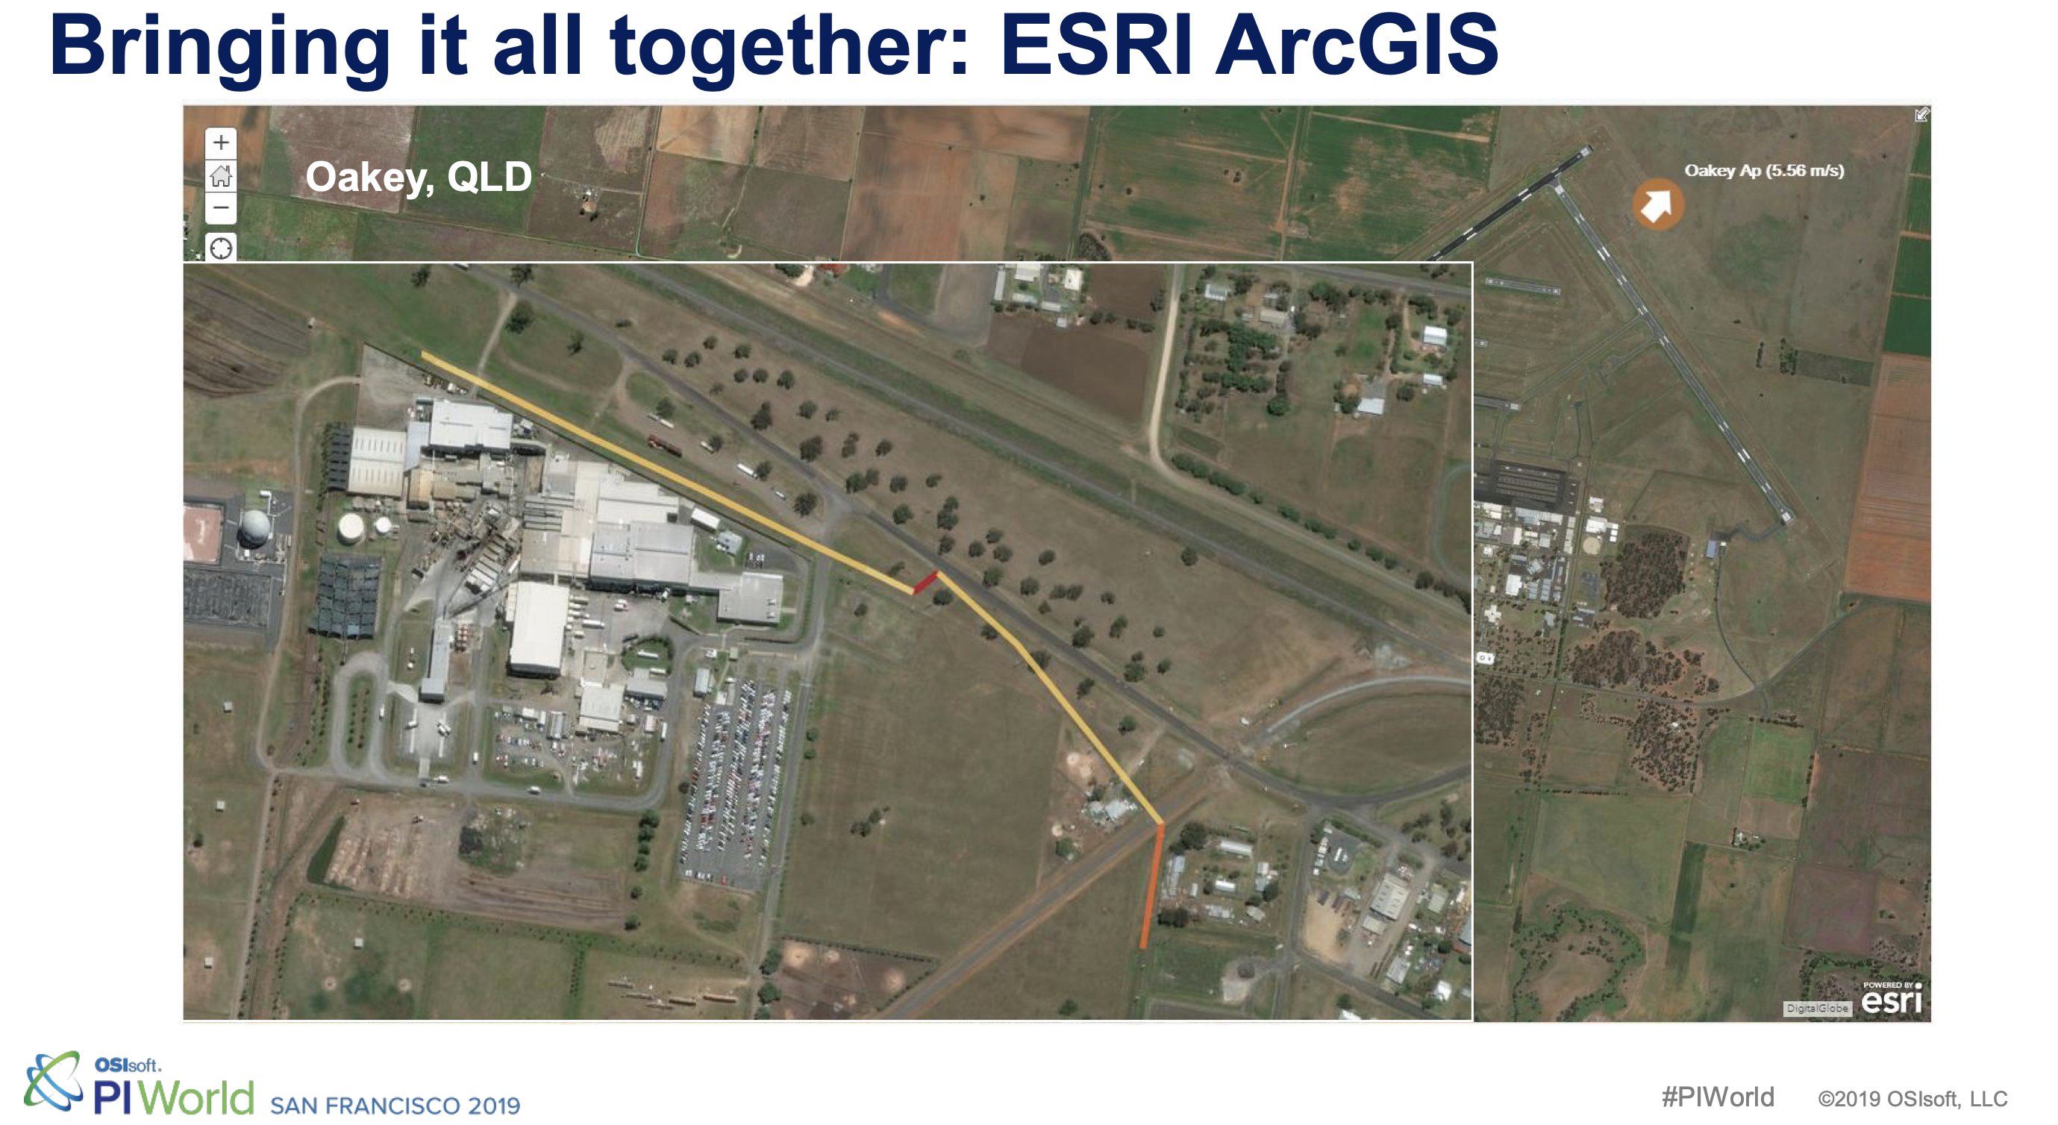
Approach: Simulate the weather loss

Slide 11








$$$
A fair fight!

Slide 12
Needs Three ingredients
Calculating the impact of weather on transmission lines
Transmissions lines
Weather Data

Slide 13
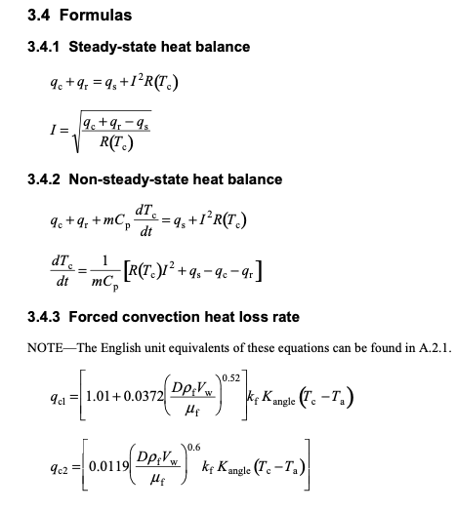

Calculations

Slide 14
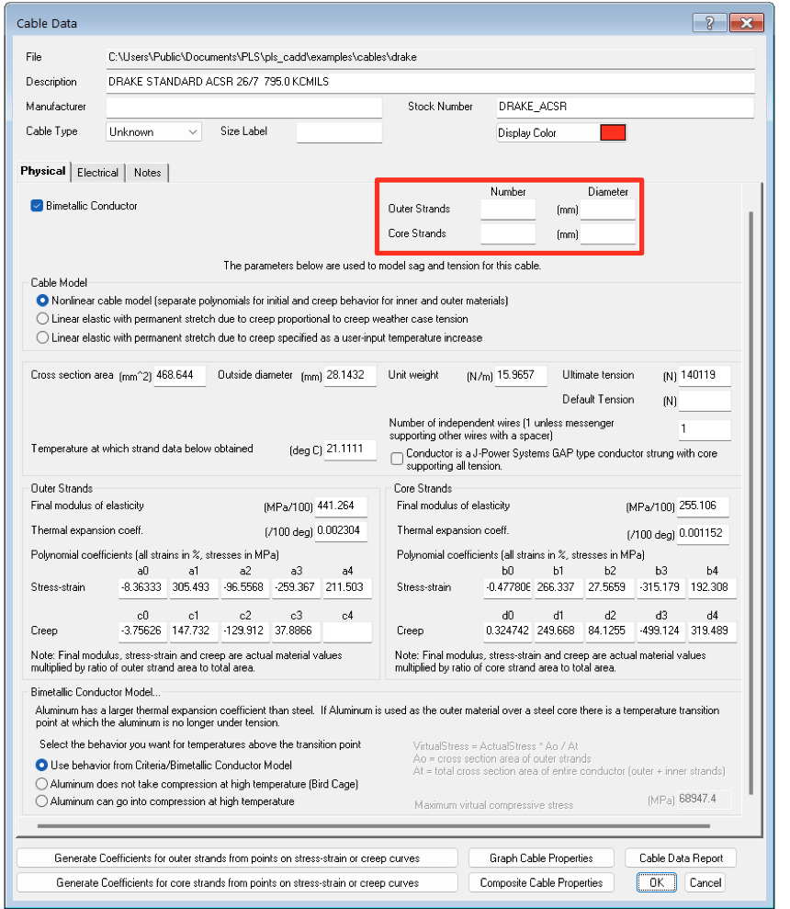
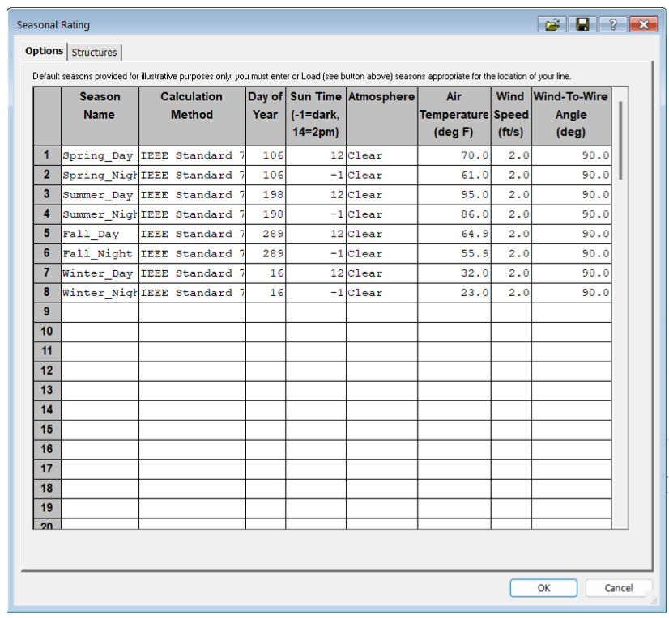
Notes:
https://www.powline.com/technotes/ThermalRating.pdf

Slide 15
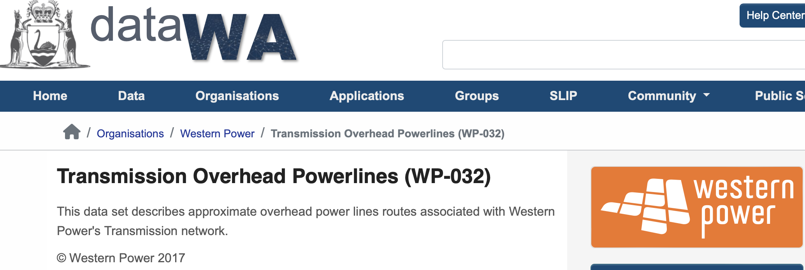
The transmission data
Geospatial data
Capacity
Name

Slide 16
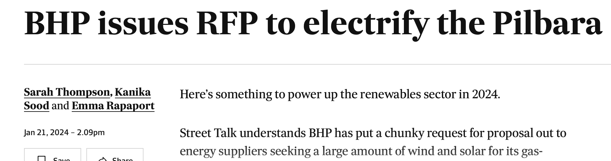
Where will new lines be built?

Slide 17
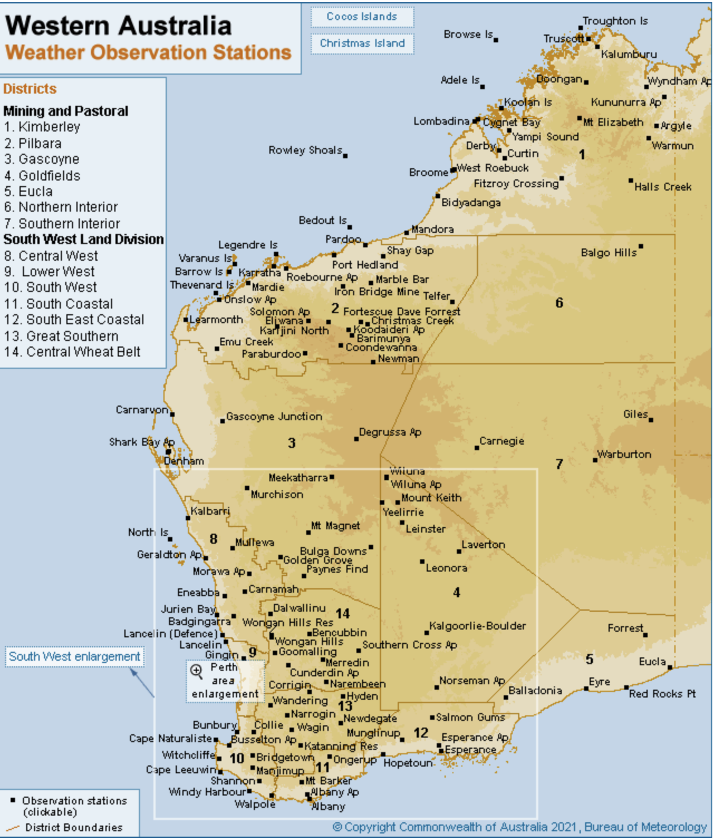
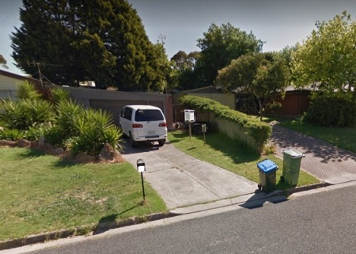
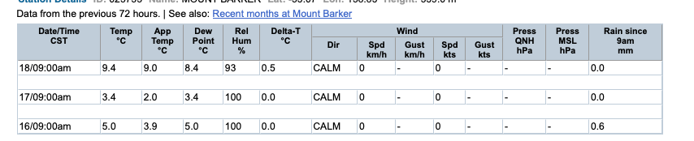
What is BOM Data

Slide 18
What is BOM Data

Slide 19
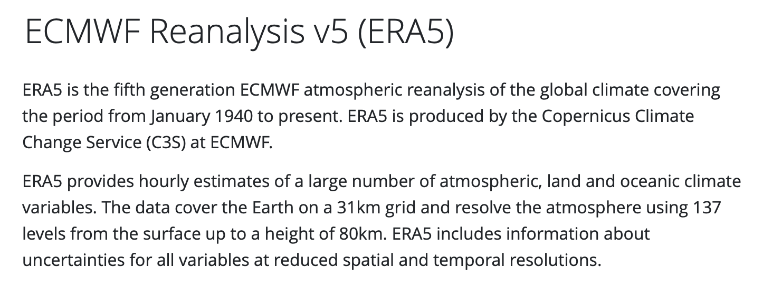
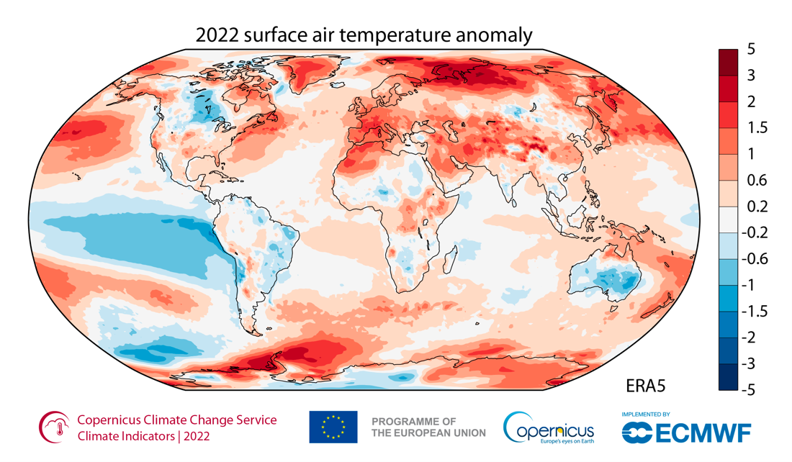
Let’s use simulated weather data
Add image

Slide 20

Weather average
Year: 200*, month: January
8am
8am
Average weather at 8am
On a January
8am
8am
8am

Slide 21
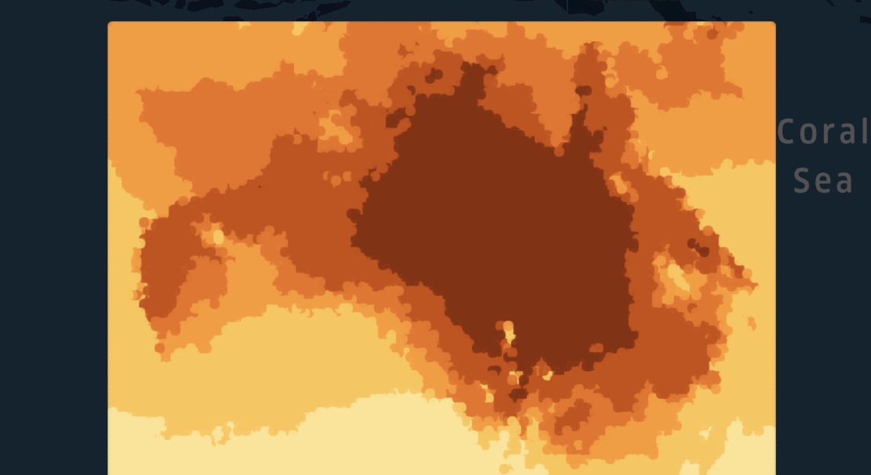
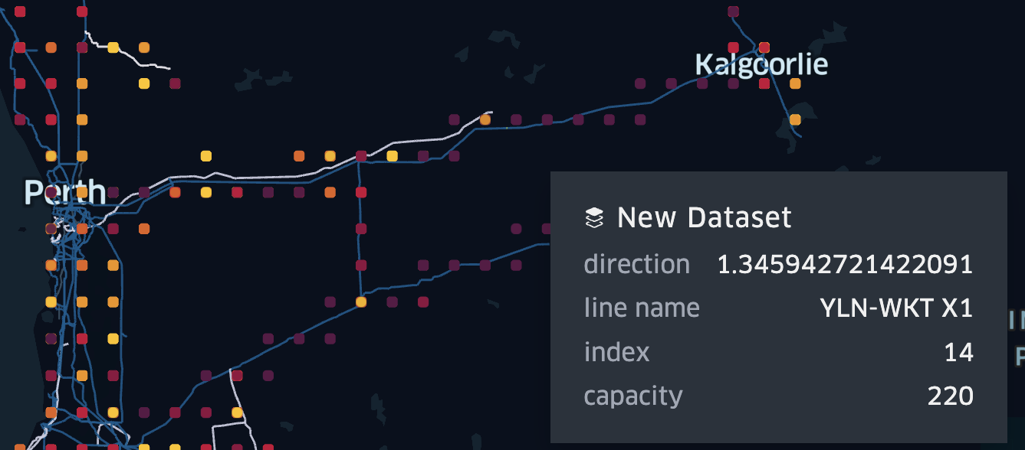
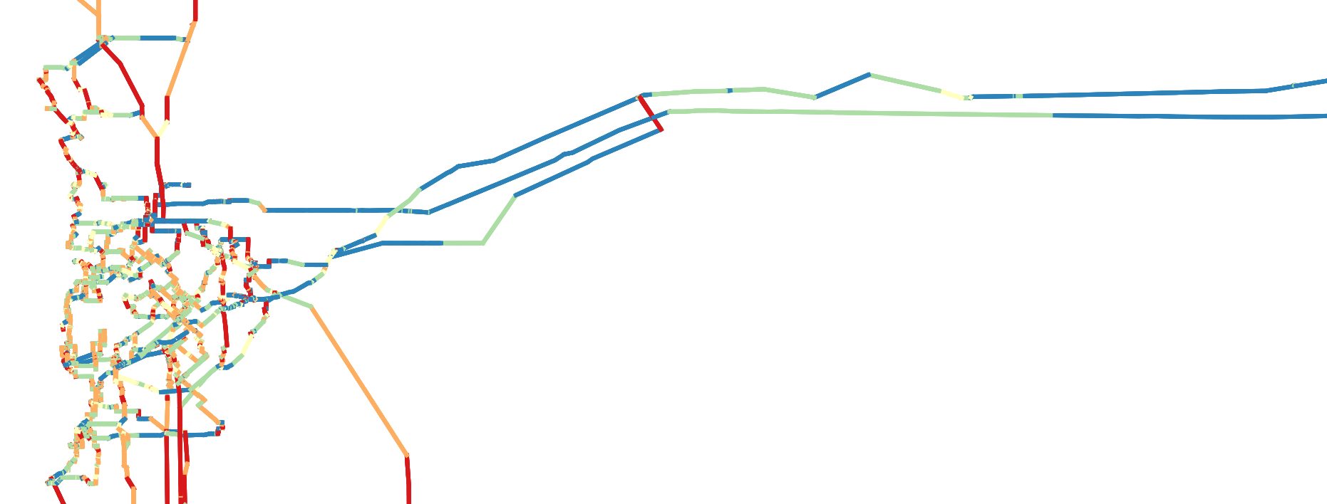
Queries
# 2 Apply some averages the to weather
#1 Split the Western Power Grid into segment, add foreign keys
#4 Add in IEEE738 Calculations (python)
#3 Joining the data set
#5, #6, #7, …
Average 8 am in June-July power efficiency gain?
Should we ask this battery to only discharge at 5 pm?
Part of the grid most impacted by the extreme weather?

Slide 22




Data Flow
Inputs
Query#1
Calculate averages
Query#3
Join the inputs
Query#4
Apply model
Query #5, #6, #7
What about this?
What about that?
Era5 or BOM Weather
.csv, .parquet, .json
Query#2 Decompose into spans
DuckDB
Scripting
Power BI/Excel,
QGIS, Grafana, qStudio
Merge
Enrich
Visualise
Western Power Transmission.shp

Slide 23

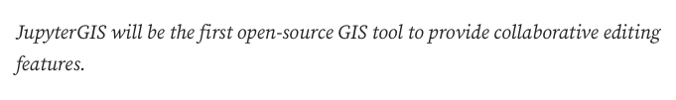
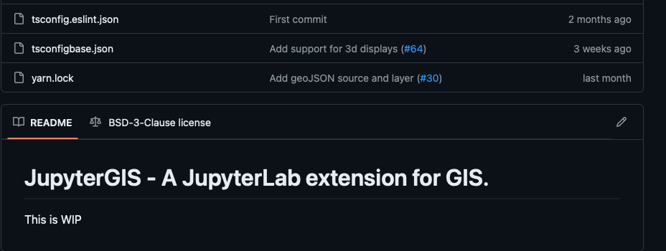

Slide 24
Other use cases
Run cloud work back on local machine
Clean-up data sets
ETL (data pipe)
Geospatial analyses
Reports on flat data
Ad-hoc queries on large data set

Slide 25
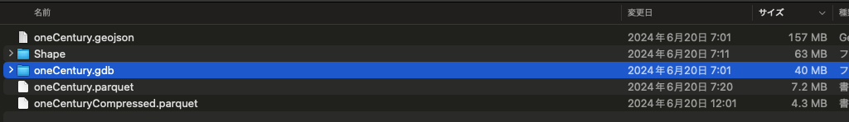
Compare sizes

